Slide 1
Chapter 07 – Part 1
Data Definition Language
&
Data Manipulation Language

Slide 2
Content
Sport Shop Problem
Solution

Slide 3
Sport Shop Problem
PST, a sport shop, has been in success of business lately. Therefore, it makes sense to establish a database to manage their products. To easily managing, they classify their products into difference types which are included type code and type name. In other words, each product type has many products and a product belongs to a product type. The sport product is described by the following properties: product code, product name, quantity, and price.

Slide 4
From the above details, designing a logical diagram with following constraints:
The product code and the product type code must be unique.
The product quantity must be greater than or equal to 0.
The product price must be greater than 0.
The second requirement is generating a physical diagram of the above database.
The last one is creating SQL statement to create all the tables in database.

Slide 5
Solution
Create Logical Diagram
Create Physical Diagram
Write SQL Statement to Create Table
Create Constraint
Other Requirement

Slide 6
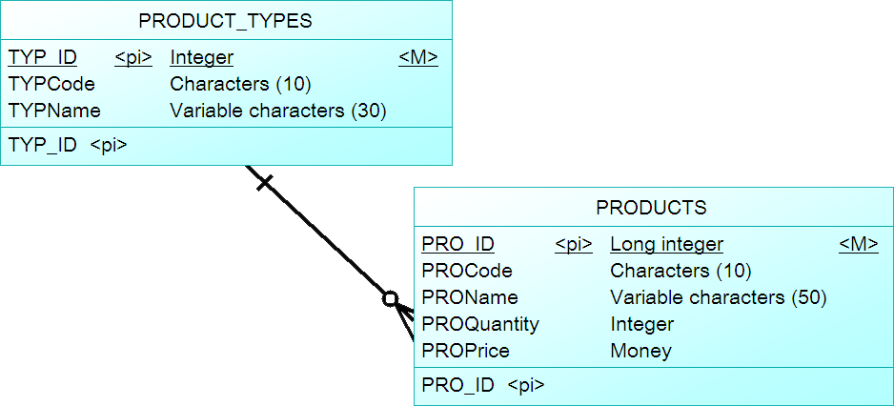
1. Create Logical Diagram
Exercise: Create logical diagram from the requirement.

Slide 7
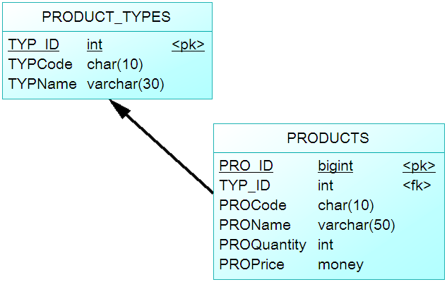
2. Create Physical Diagram
Exercise: Generate physical diagram from the above logical diagram.

Slide 8
3. Write SQL Statement to Create Table
3.1. Database creating
3.2. DDL Code for Product_Types table
3.3. DDL Code for Products table
3.4. Relationship creating

Slide 9
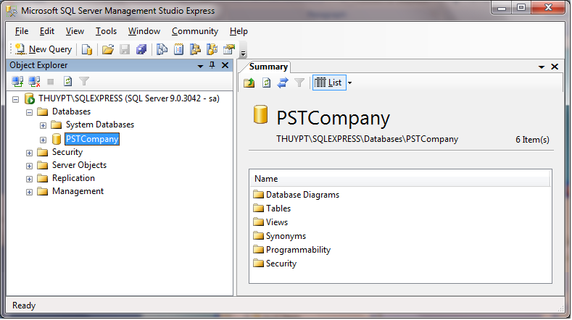
3.1. Database creating
Use the below SQL:
Create Database PSTCompany;
Or

Slide 10
3.2. DDL Code for Product_Types table
CREATE TABLE PRODUCT_TYPES (
TYP_ID int not null,
TYPCode char(10),
TYPName varchar(30),
Constraint PK_PRODUCT_TYPES Primary Key (TYP_ID)
);

Slide 11
3.3. DDL Code for Products table
CREATE TABLE PRODUCTS (
PRO_ID bigint Primary Key identity,
TYP_ID int not null,
PROCode char(10),
PROName varchar(50),
PROQuantity int,
PROPrice money
);

Slide 12
3.4. Relationship creating
To create relationship between two tables, using following SQL statement:
Alter Table PRODUCTS
Add constraint FK1 Foreign Key (TYP_ID) References PRODUCT_TYPES (TYP_ID)
on update cascade on delete cascade;
Cascading Updates and Deletes
A Cascading update occurs when a change to the parent’s primary key is applied to the child’s foreign key.
A Cascading delete occurs when associated child rows are deleted along with the deletion of a parent row.

Slide 13
4. Create Constraint
4.1. Create Unique Constraint
4.2. Create Check Constraint

Slide 14
4.1. Create Unique Constraint
To set unique value (Candidate Key) for Pro_Code in Products table, using the following SQL statement:
Alter Table PRODUCTS
Add Constraint AK_Product Unique (PROCODE);
To set unique value (Candidate Key) for Typ_Code in Product_Types table, using the following SQL statement:
Alter Table PRODUCT_TYPES
Add Constraint AK_Product_Type Unique (TYPCODE);

Slide 15
4.2. Create Check Constraint
To create a constraint to check quantity must be greater than or equal to 0.
Alter Table PRODUCTS
Add Constraint Chk_Quantity Check (PROQuantity >= 0);
To create a constraint to check product price must be greater than 0.
Alter Table PRODUCTS
Add Constraint Chk_Price Check (PROPrice > 0);

Slide 16
5. Other Requirement
5.1. Modify Table Problem
5.2. Modify Table Solution

Slide 17
5.1. Modify Table Problem
After creating tables, do the following requirements:
Create a product type which includes following information.
Product type code: Cloth
Product type name: Cloth Sport
Create two following products for Cloth product type.
First product has PRO1 code, men T-shirt name, 10 quantities and 20$ for price.
Second product has PRO2 code, Nike Hat name, 15 quantities and 10$ for price
Then, update quantity of product has PR01 from 10 to 20.
Finally, delete the product has PR02 from PRODUCTS table.

Slide 18
5.2. Modify Table Solution
5.2.1. Insert a Product Type
5.2.2. Insert Products
5.2.3. Update a Product
5.2.4. Delete a Product

Slide 19

5.2.1. Insert a Product Type
In order to insert a row (record) into Product Types table, using following SQL statement:
Insert Into PRODUCT_TYPES (Typ_ID, TypCode, TypName)
Values (1, ‘Cloth’, ‘Cloth Sport’);

Slide 20
2.2. Insert Products
Those products belong to Cloth product type. Therefore, they must prefer to 1 which is Cloth’s ID.
Insert Into PRODUCTS (Typ_ID, ProCode, ProName, ProQuantity, ProPrice)
Values (1, ‘PRO1’, ‘Men T-shirt’, 10, 20);
Insert Into PRODUCTS (Typ_ID, ProCode, ProName, ProQuantity, ProPrice)
Values (1, ‘PRO2’, ‘Nike Hat’, 10, 10);

Slide 21
2.3. Update a Product
In order to update product quantity of ‘PRO1’ to 20, using following SQL statement:
Update PRODUCTS
Set ProQuantity = 20
Where ProCode = ‘PRO1’;

Slide 22
2.4. Delete a Product
Using following statement to delete product(s):
Delete From PRODUCTS
Where ProCode = ‘PRO2’;

Slide 23

?

